Slide 2
What is BioASQ
BIOASQ initiates a series of challenges on biomedical semantic indexing and question answering (QA).
Participants will be required to index semantically content from large-scale biomedical sources (e.g., MEDLINE) and/or
to assemble data from multiple heterogeneous sources (e.g., scientific articles, knowledge bases, databases)
to compose informative answers to biomedical natural language questions.

Slide 3
Examples
Issue 1: Evaluate the safety and the effects of T3 treatment in patients with acute myocardial infarction.
Q1: What is the role of thyroid hormones administration in the treatment of heart failure?
Issue 2: Evaluate the effects of TNF blockade in opportunistic infection.
Q2: Does TNF blockade cause opportunistic infection?
Unfortunately, the questions cannot be submitted directly to current bibliographic databases ...

Slide 4
Example 1 Q1: What is the role of thyroid hormones administration in the treatment of heart failure
Identify related terms/concepts
heart failure, infarction, thyroid hormone treatment
Retrieve and select relevant snippets
Signaling Mechanisms in Thyroid Hormone-Induced Cardiac Hypertrophy
... possibility of their therapeutic utility in the treatment of the post-infarcted heart or in heart failure.
... Cardiac growth in response to thyroid hormones (L-thyroxine, T4 ...
…
[PMIDs: 20005976, 21860776]
Consolidate relevant snippets as answers
Cardiac growth may be a response to thyroid hormones. Thus, administration of thyroid hormones may be useful in the treatment of heart failure. Subclinical hypothyroidism may be a cause of heart failure.

Slide 5
Example 2 Q2: Does TNF blockade cause opportunistic infection?
Identify related terms/concepts
TNF blockade, anti-tumor therapy, opportunistic infection
Retrieve and select relevant snippets
Opportunistic infections, especially reactivation with M. tuberculosis, are major complications during treatment with anti-TNF agents ...
Neutralization of TNF causes a decrease in the inflammatory response but increases susceptibility to opportunistic infections such as fungal infections ...
... association of anti-tumor necrosis factor therapy with opportunistic infections in rheumatoid arthritis (RA) patients has been reported ...
... all anti-TNF agents have been associated with a variety of serious and "routine" opportunistic infections, particularly tuberculosis ...
…
[PMIDs: 22770648, 22398055, 22354637, 22311162]
Consolidate relevant snippets as answers
TNF neutralization and anti-TNF agents have been reported to be associated with opportunistic infections, particularly tuberculosis.

Slide 6
Biomedical semantic indexing and QA

Slide 7
Challenge Objectives
The challenge (aka competition or shared task) will assess:
large-scale classification of biomedical documents onto ontology concepts (semantic indexing),
classification of biomedical questions onto relevant concepts,
retrieval of relevant document snippets, concepts and knowledge base triples,
delivery of the retrieved information in a concise and user-understandable form.

Slide 8
The challenge
Imaginary participant: MedAnswers Inc.
Task 1a: Large-scale online biomedical semantic indexing
BioASQ distributes new unclassified PubMed documents
MedAnswers attaches MeSH terms
Evaluation when abstracts get classified by PubMed curators.

Slide 9
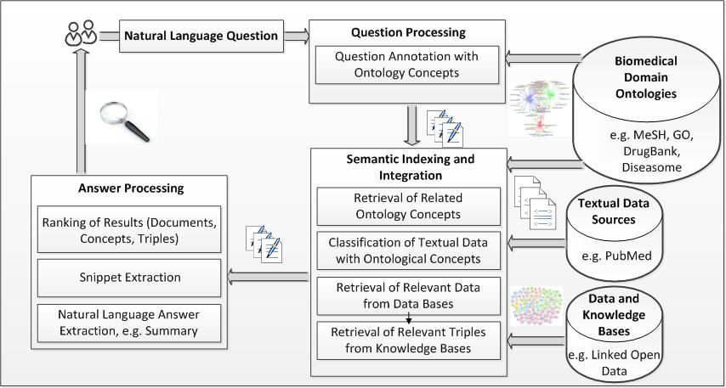
The challenge
Task 1a

Slide 10
The challenge
Imaginary participant: MedAnswers Inc.
Task 1b: Introductory biomedical semantic QA
Stage A:
BioASQ distributes questions from benchmark
MedAnswers responds with concepts, snippets, triples
Stage B:
BioASQ distributes questions + concepts, snippets, triples
MedAnswers responds with exact answers or summaries
Evaluation with gold answers, majority and manually (sample)

Slide 11
The challenge
Task 1b

Slide 12
The Challenge
Task 2a: same as 1a, with new data and improvements
Task 2b: (similar to 1b, but only one stage)
BioASQ distributes questions from new benchmark
MedAnswers responds with concepts, snippets, triples, exact answers or summaries, etc.
Evaluation with gold answers, majority and manually (sample)

Slide 13
Evaluation Measures
Task 1a: Large-scale online biomedical semantic indexing
Precision, Recall, F-Measure and hierarchical variants
Task 1b: Introductory biomedical semantic QA
Stage A (concepts, snippets, triples):
Precision, Recall, F-Measure
Stage B:
Exact answers: Accuracy, MRR, similarity to majority
Summaries: ROUGE or similar, similarity to centroid
Each type of response evaluated separately.
Participation can be partial.

Slide 14
Challenge Data – QA Benchmarks
Sources:
PubMed Central articles
Biomedical knowledge bases (e.g. MeSH/UMLS, Jochem, SwissProt, Diseasesome).
Volume: Minimum 300 questions per challenge, plus relevant concepts, triples and snippets, gold answers.
Produced by: a team of biomedical experts, using a specialized annotation tool.
Sustainability: BioASQ social network to support new benchmarks and evaluation campaigns. Annotation tool freely available with the social network.

Slide 15
Annotation tool - mockup

Slide 16
Social Network OntoWiki-DSSN as basis
Distributed Semantic Social Network built upon OntoWiki components
concrete implementation of DSSN on top of OntoWiki
Resource-centric
Questions and answers modeled as resources
Editing, discussion, subscription (i.e. follow a resource), change management
Custom user interface for domain experts
hide technical details of RDF
Distributed for scalability

Slide 17
Participation
Diverse and multi-disciplinary target: bioinformatics, medical informatics, information retrieval, machine learning, natural language processing, text mining.
Academia and industry (interest expressed by Microsoft Research, Yahoo!, Xerox and others).
Simultaneous transmission of questions – time-limits on answers.
Easy submission of results through Web services.
Large hardware infrastructure (a cluster of ~5000 cores) available for those who want to use it.
Prizes to the best performing systems per task.
Outstanding methods will be presented in a special issue.

Slide 18
Draft Schedule - 1st Challenge
March 2013: Evaluation infrastructure and dry-run data available for testing.
June 2013: Start of the challenge.
August 2013: End of the challenge.
September 2013: BioASQ workshop.
Evaluation infrastructure & dry-run data
Start of the challenge
End of the challenge
BioASQ workshop
March 2013 June 2013 August 2013 September 2013

Slide 19
BioASQ Project
BioASQ challenge series will be organized by the BioASQ project.
Funded by the European Commission, under FP7 ICT-2011.4.4 Intelligent Information Management.
Start: October 1, 2012 – End: September 30, 2014
Budget: 1.27 MEuro

Slide 20
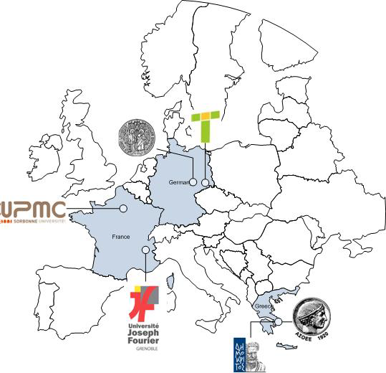
Project Consortium
National Centre for Scientific Research “Demokritos” -NSCR “D” (EL)
Transinsight GmbH – TI (D)
Universite Joseph Fourier- UJF (F)
University Leipzig - ULEI (D)
Universite Pierre et Marie Curie Paris 6 – UPMC (F)
Athens University of Economics and Business – Research Centre – AUEB-RC (EL)

Slide 21
Thank you! www.bioasq.org
Evaluation infrastructure & dry-run data
Start of the challenge
End of the challenge
BioASQ workshop
March 2013 June 2013 August 2013 September 2013

Slide 22
