Slide 1
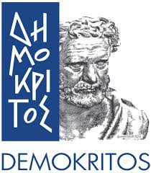

Bridging the European Earth-Observation and AI
Communities for Data-Intensive Innovation
Reinforcing the AI4EU Platform by Advancing
Earth Observation Intelligence, Innovation & Adoption
Antonis Troumpoukis, NCSR “Demokritos”
a joint work with Iraklis Klampanos, Despina-Athanasia Pantazi, Eleni Tsalapati, Mohanad Albughdadi, Mihai Alexe, Vasileios Baousis, Omar Barrilero, Bryce Billière, Alexandra Bojor, Pedro Branco, Lorenzo Bruzzone, Andreina Chietera, Philippe Fournand, Richard Hall, David Hassan, Michele Lazzarini, Adrian Luna, Dharmen Punjani, George Stamoulis, Giulio Weikmann, Marcin Ziółkowski, Xenia Ziouvelou, Manolis Koubarakis and Vangelis Karkaletsis

Slide 2
Outline
The European AI & EO communities
The AI4Copernicus framework
  User journey
  Cloud resources and services
  Bootstrapping services and tools
  Semantic services and tools
Use cases
Evaluation
Conclusions & Future Work

Slide 3
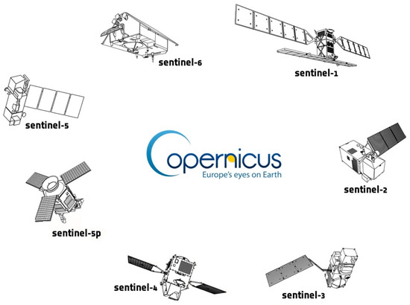
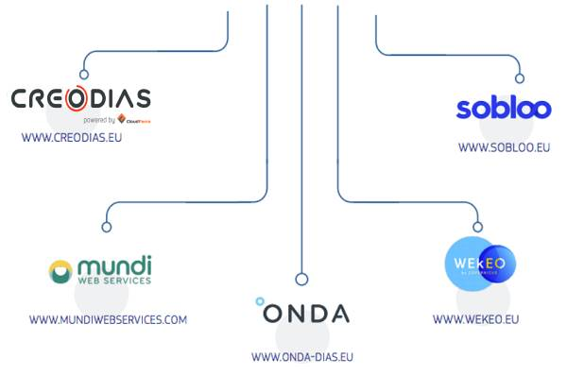
The Copernicus programme
Copernicus is the European programme for monitoring the Earth
Set of systems that collect data from satellites and in-situ sensors
Free and openly accessible to users
To facilitate and standardise access to data, the EC has funded the deployment of five DIASes

Slide 4

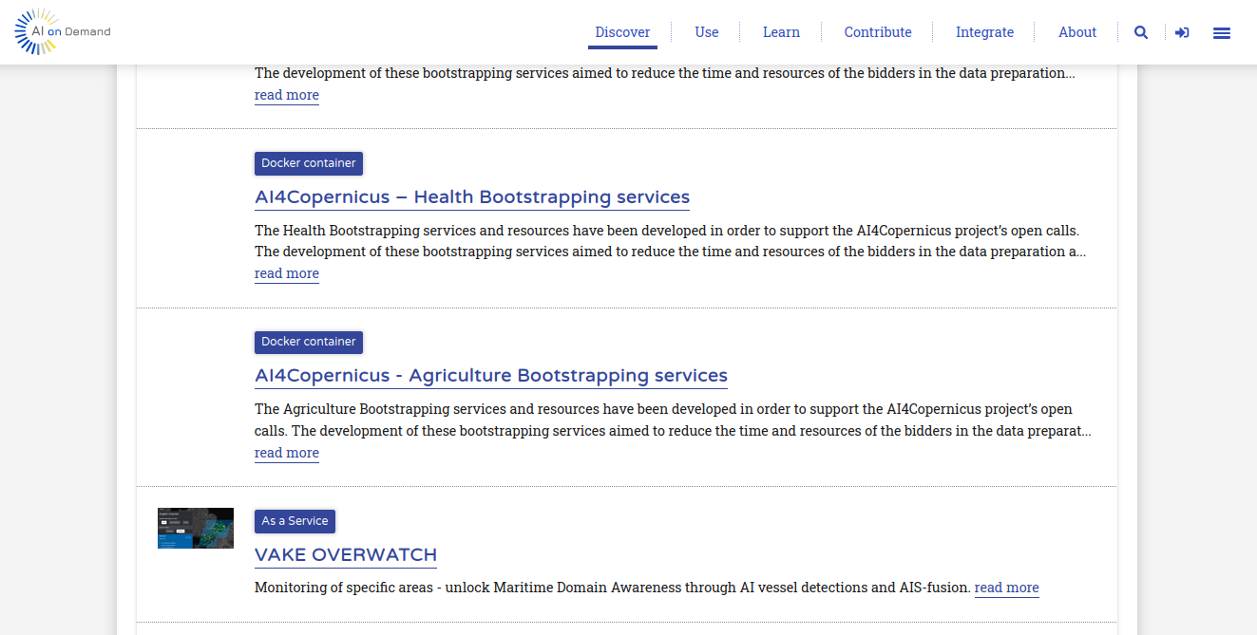
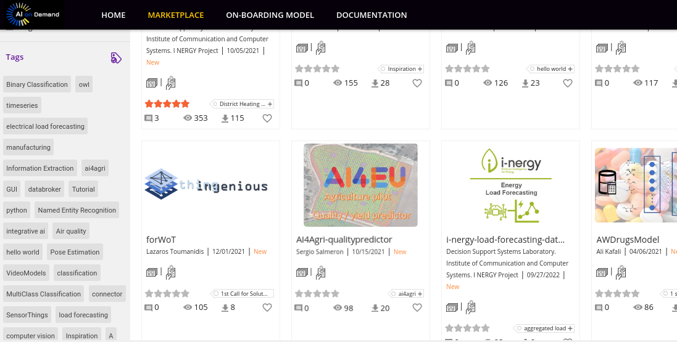
The AI-on-Demand platform
The AI on-Demand Platform https://www.ai4europe.eu/ (AIoD) is a platform for sharing AI resources produced in European projects, including high-level services, expertise in AI research and innovation, AI components and datasets, high-powered computing resources. It offers a catalogue of AI assets an open source platform for experimenting and deployment of AI pipelines.
AIoD Catalogue
AI4Experiments

Slide 5
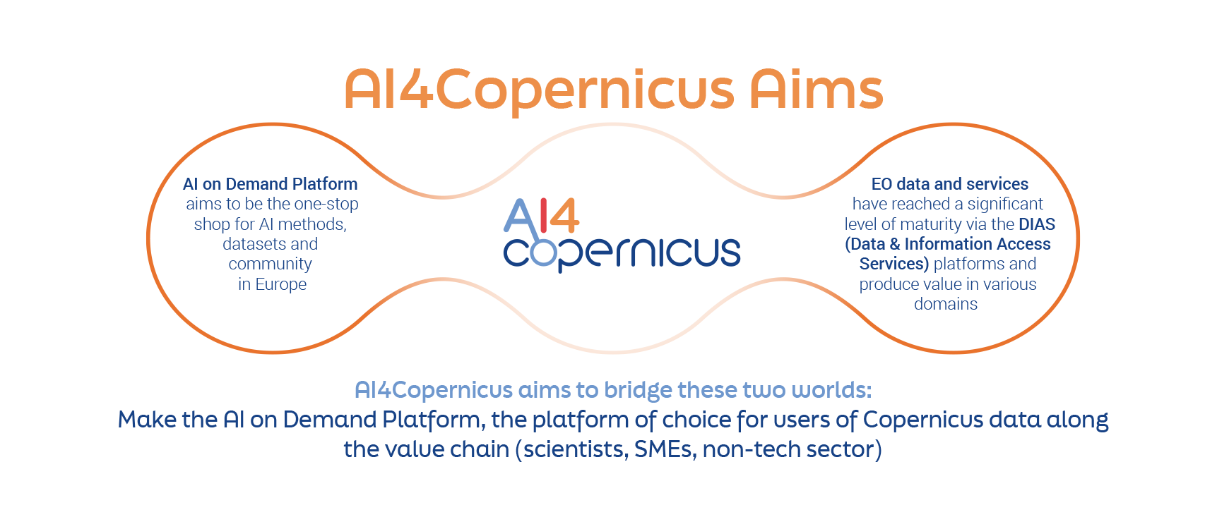
The AI4Copernicus project
financial support through a series of Open Calls
services and tools to bootstrap the development of AI+EO applications

Slide 6


User Journey in AI4Copernicus
Discover the appropriate AI asset on the AIoD catalogue
Access the AI assets through CREODIAS Docker Registry
Develop on CREODIAS/WEkEO
Onboard onto AI4Experiments, possibly making use of additional resources
Deploy the solution on CREODIAS
Publish the solution and/or derivatives onto the AIoD catalogue
Docker Registry
AIoD catalogue
Cloud Resources
AI4Experiments

Slide 7
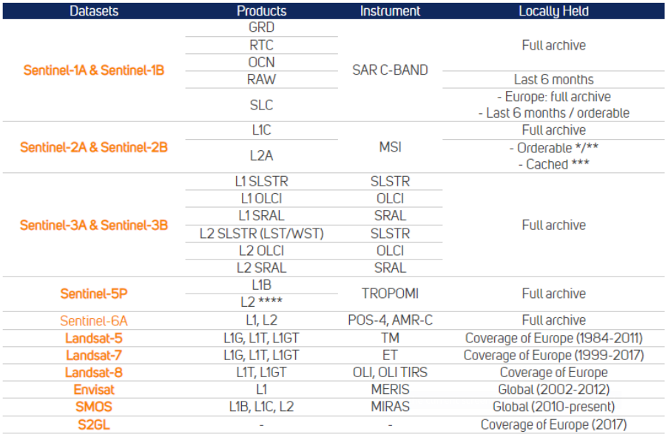

Cloud Resources and Services
Access to DIAS
  CREODIAS http://creodias.eu
  WEKEO http://wekeo.eu
Provisioning of Cloud & Computing services
  Copernicus data products
  Kubernetes cluster
  Docker Registry

Slide 8
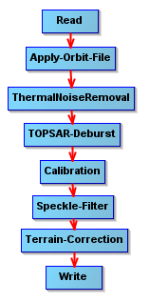
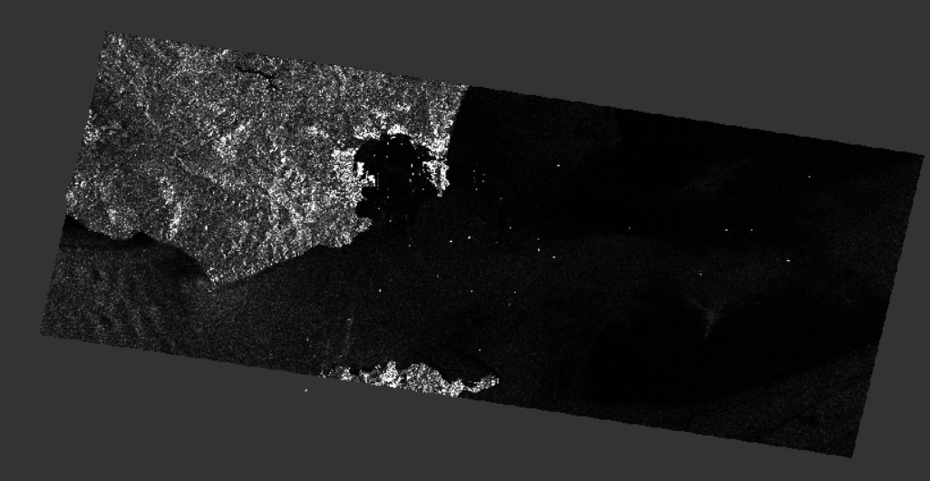
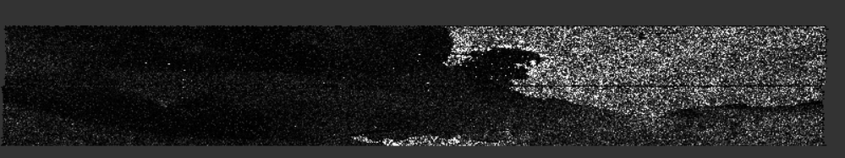
Security Bootstrapping Service
S1 and S2 pre-processing
General tools for ingesting satellite images from S1 and S2:
  Sentinel-1 GRD pre-processing
  Sentinel-1 SLC pre-processing
  Sentinel-2 pre-processing
S1 SLC pre-processing
pipeline
terrain-corrected calibrated backscatter
S1 SM/IW SLC

Slide 9
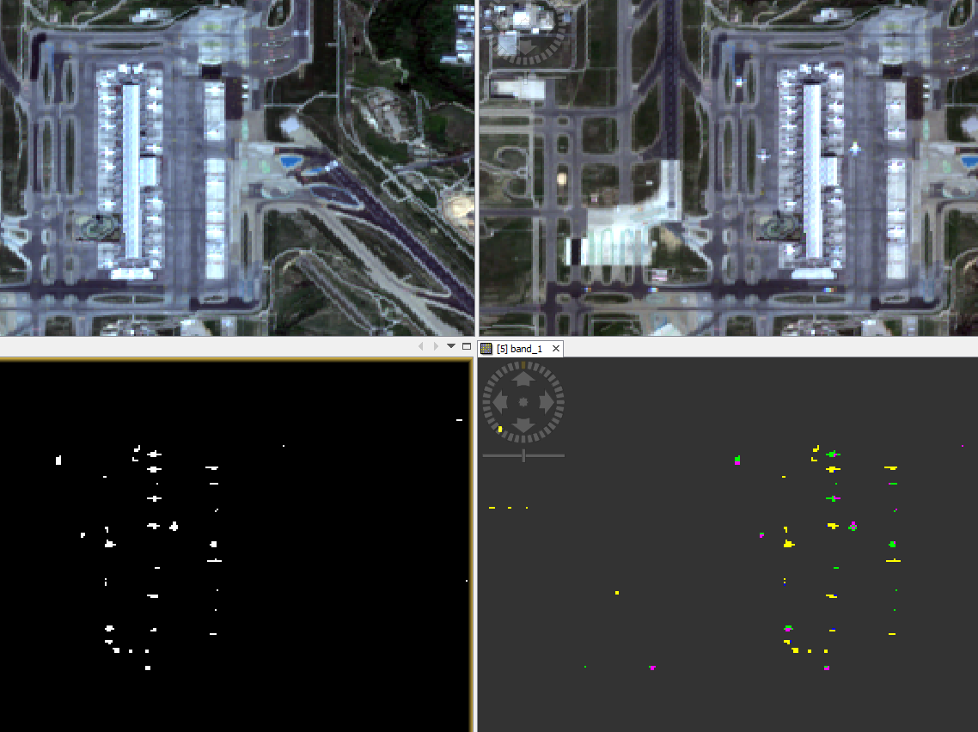
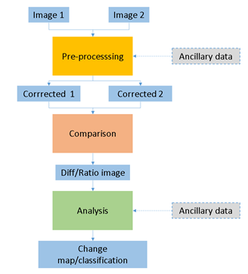
Security Bootstrapping Service
S1 and S2 change detection
Change detection pipelines for S1 and S2:
  Sentinel-1 Change detection: Amplitude Change Detection and Multi-temporal Coherence
  Sentinel-2 Change detection
S2 Change Detection
pipeline
CVA Changes
Pair of S2 L2A

Slide 10
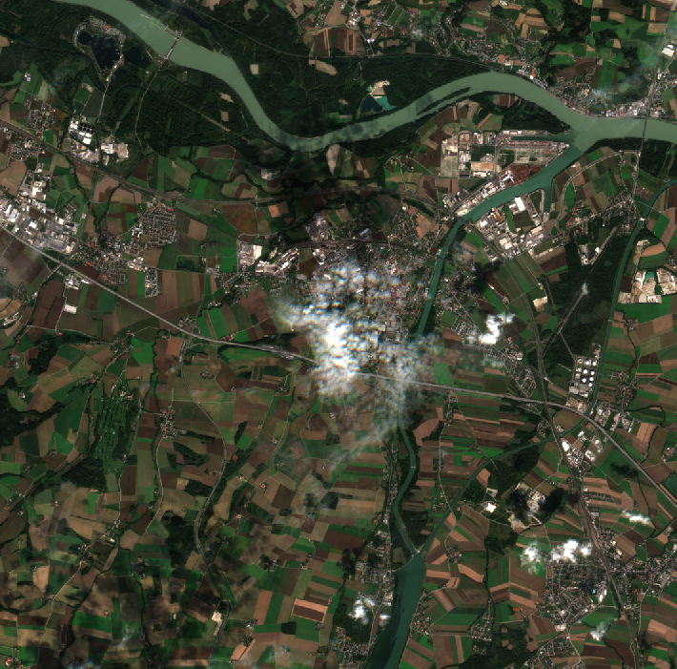
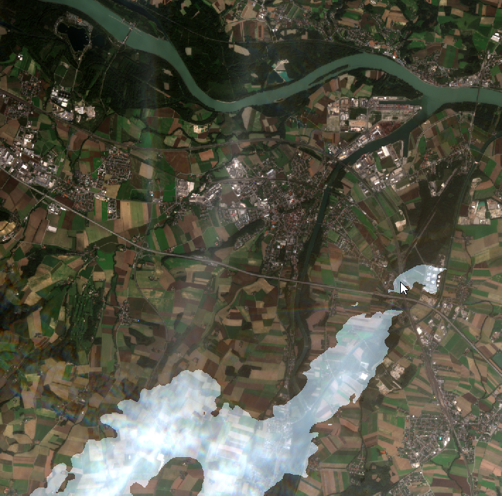
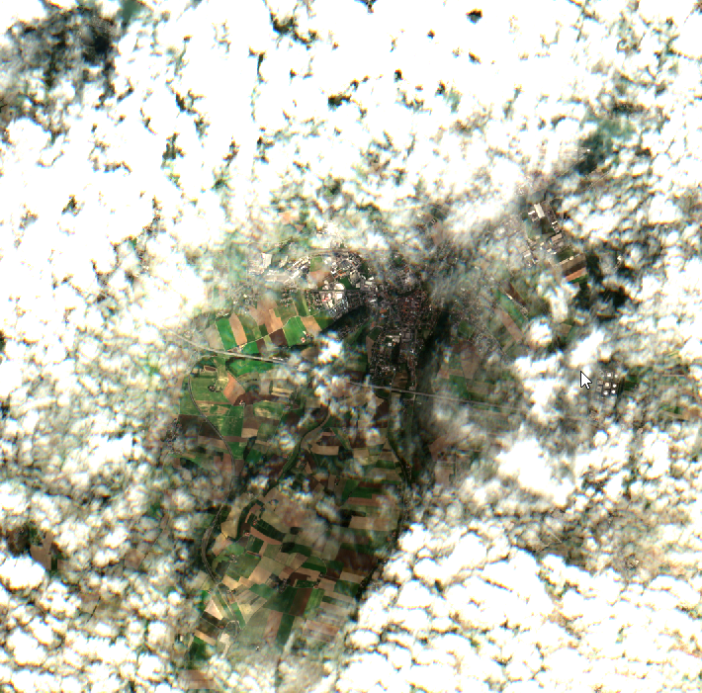
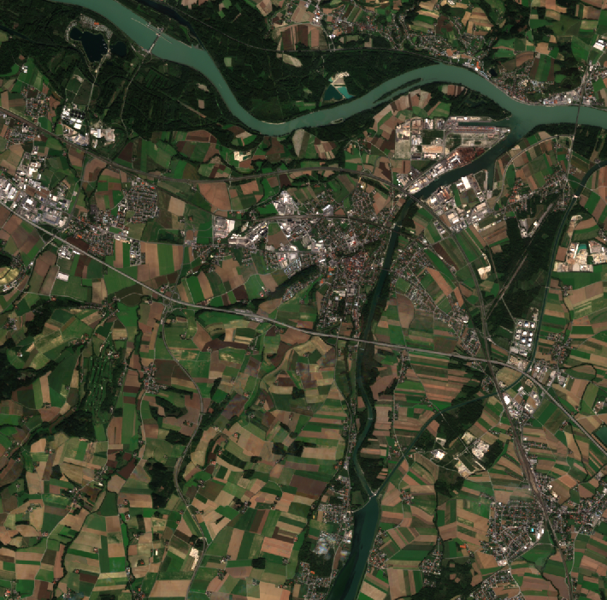
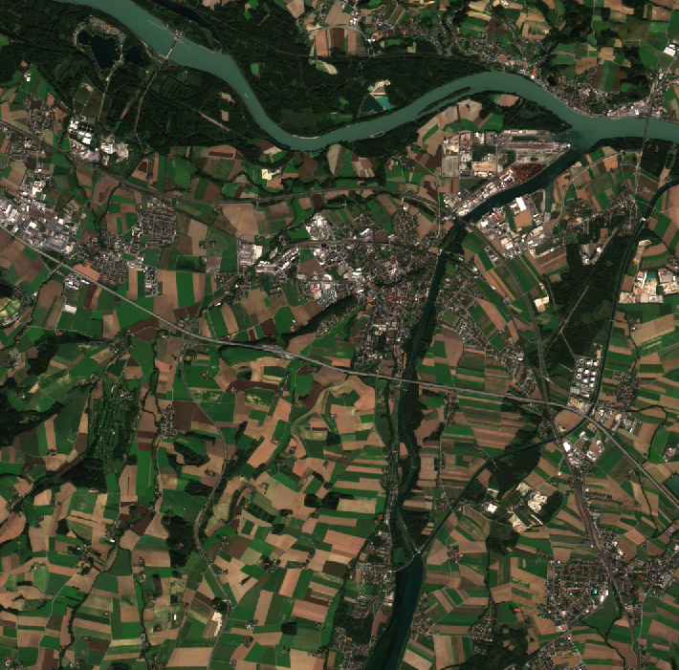
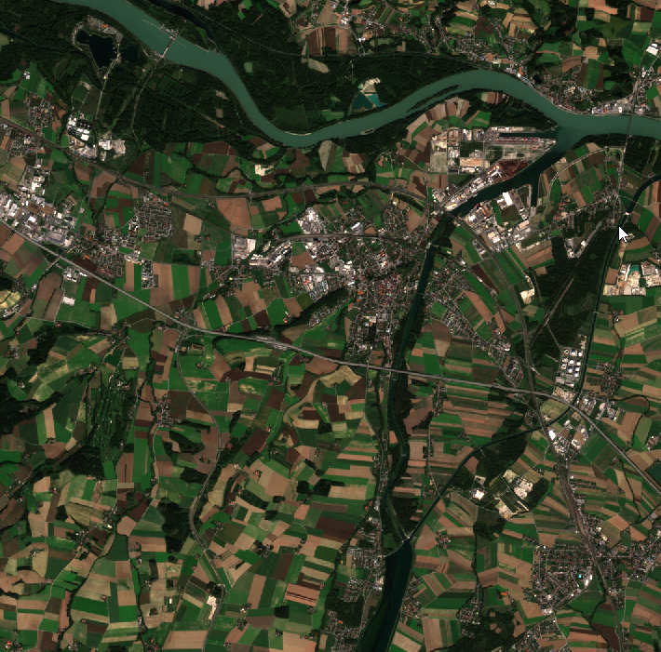
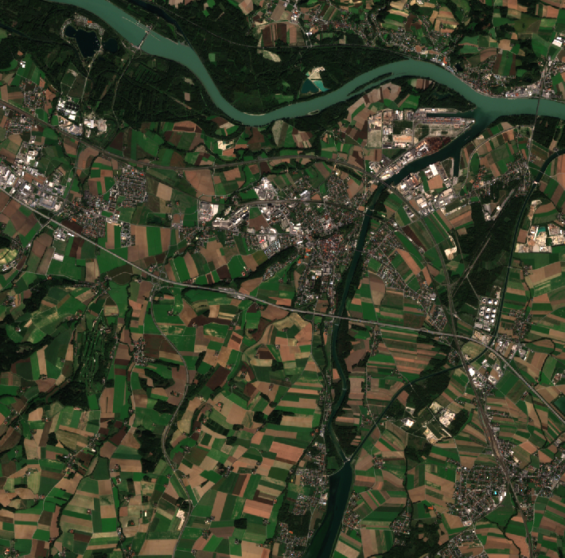
Agriculture Bootstrapping Service
S2 Tile Harmonization
The service aim to harmonize Sentinel-2 Time Series (TSs) through a monthly composite approach to create temporally homogeneous time series.
Allows processing of different TSs length.
Mitigates the presence of clouds in the scene.
8th September
11st September
13rd September
Monthly Composite
(September)
18th September
21st September
28th September

Slide 11
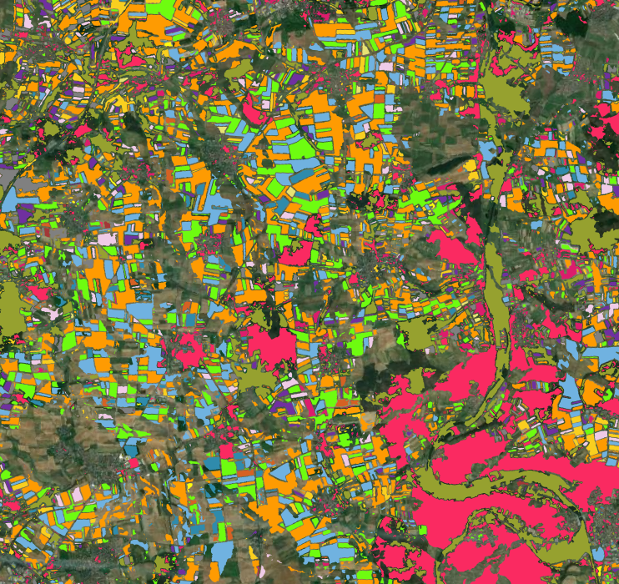
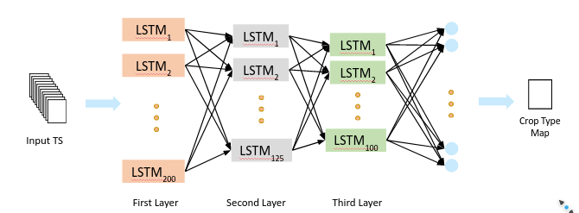
Agriculture Bootstrapping Service
LSTM for S2 for crop type classification
Pe-trained Long Short-Term Memory (LSTM) for crop-type classification.
  Input: S2 time series (e.g. monthly composites)
  Output: crop-type map
The network can also be trained from scratch, either using the (publicly available) TimeSen2Crop dataset or with a dataset created by the user.

Slide 12
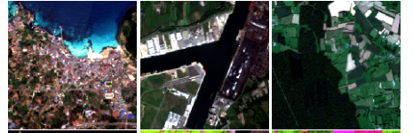

Deep Network for pixel-level classification of S2 patches
Allow user to train pixel-level segmentation models on Sentinel-2 (S2) images.
The goal is to detect one of/a combination of S2 classes: crop types (corn, sunflower, wheat, etc), land cover (urban vs natural, water vs land), road extraction (road vs other).
Segmentation

Slide 13
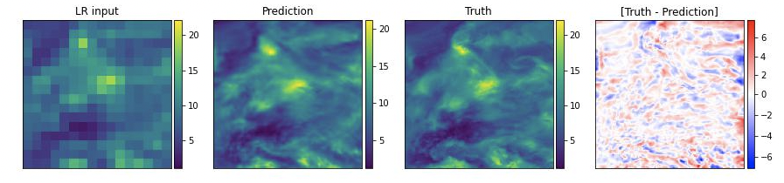
Probabilistic downscaling of CAMS data
Address current public health and air pollution / quality challenges using EO.
Probabilistic downscaling (super-resolution) of CAMS air quality (AQ) and atmospheric composition (AC) model output (using GANs).
Example: Super-resolution of PM2.5 (80km to 10km)

Slide 14


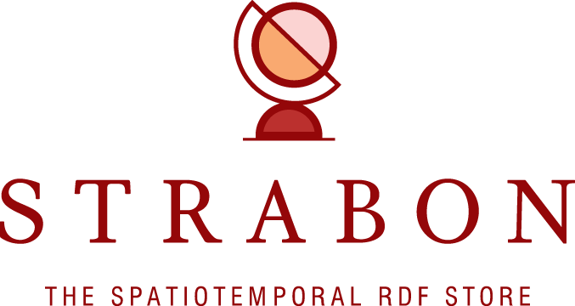


Linked Data Pipeline
A pipeline for transforming, linterlinking, querying, federating, and visualizing Big Linked Geospatial Data.
SPARQL
Endpoint
GeoSPARQL
Endpoint
Data
Data
Data

Slide 15
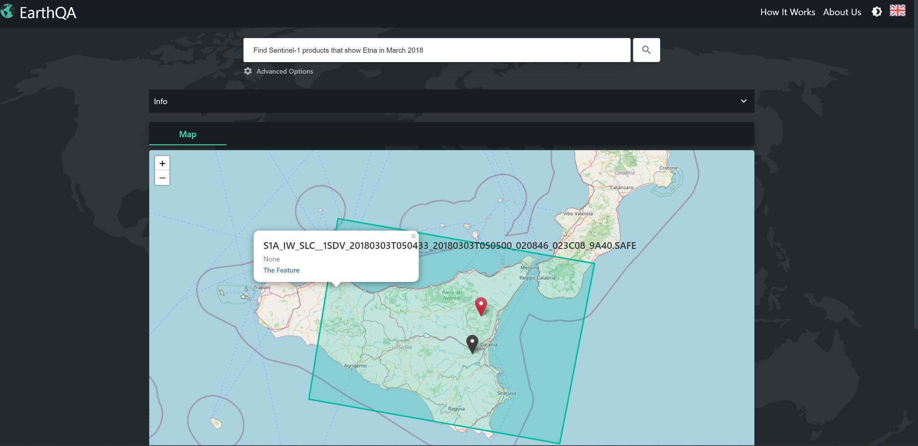
EarthQA question answering engine
EarthQA accepts questions in natural language (English) that ask for EO datasets having certain properties and returns links to such datasets.
Example: Find Sentinel-1 products that show Etna in March 2018.

Slide 16
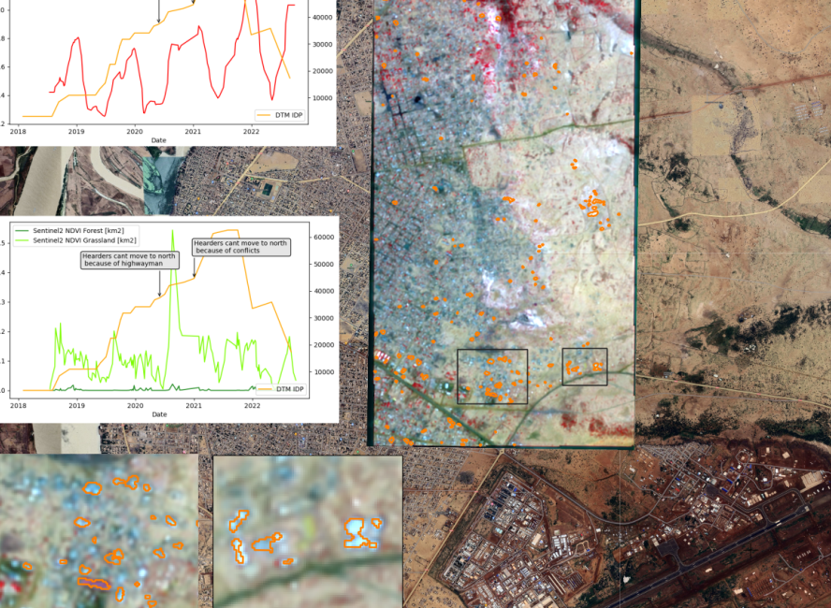
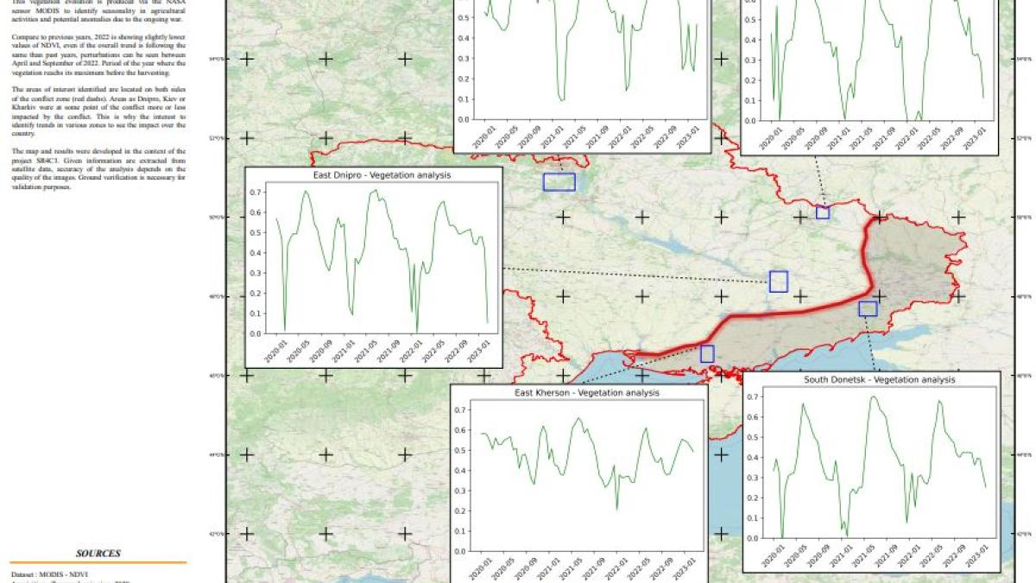
Use case 1: Monitoring of conflict or crisis affected areas
Domain: Security
Project: SR4C3
Companies: Sistema GmbH, CMC Consulting
Countries: Austria, Belgium
Problem: Identification of the impact of conflicts on environment
Solution: Single Image Super Resolution of Sentinel-2 images. Urban monitoring and abandoned crop detection on top of it.
AI Techniques:
  10m to 3m Sentinel-2 spatial resolution enhancement
  Sentinel-1 / Sentinel-2 fusion for vegetation monitoring
AI4Copernicus services used:
  Cloud resources
  Sentinel-1 preprocessing
  Mentoring services
Displacement movement and cropland changes monitoring in Mali and Ukraine

Slide 17
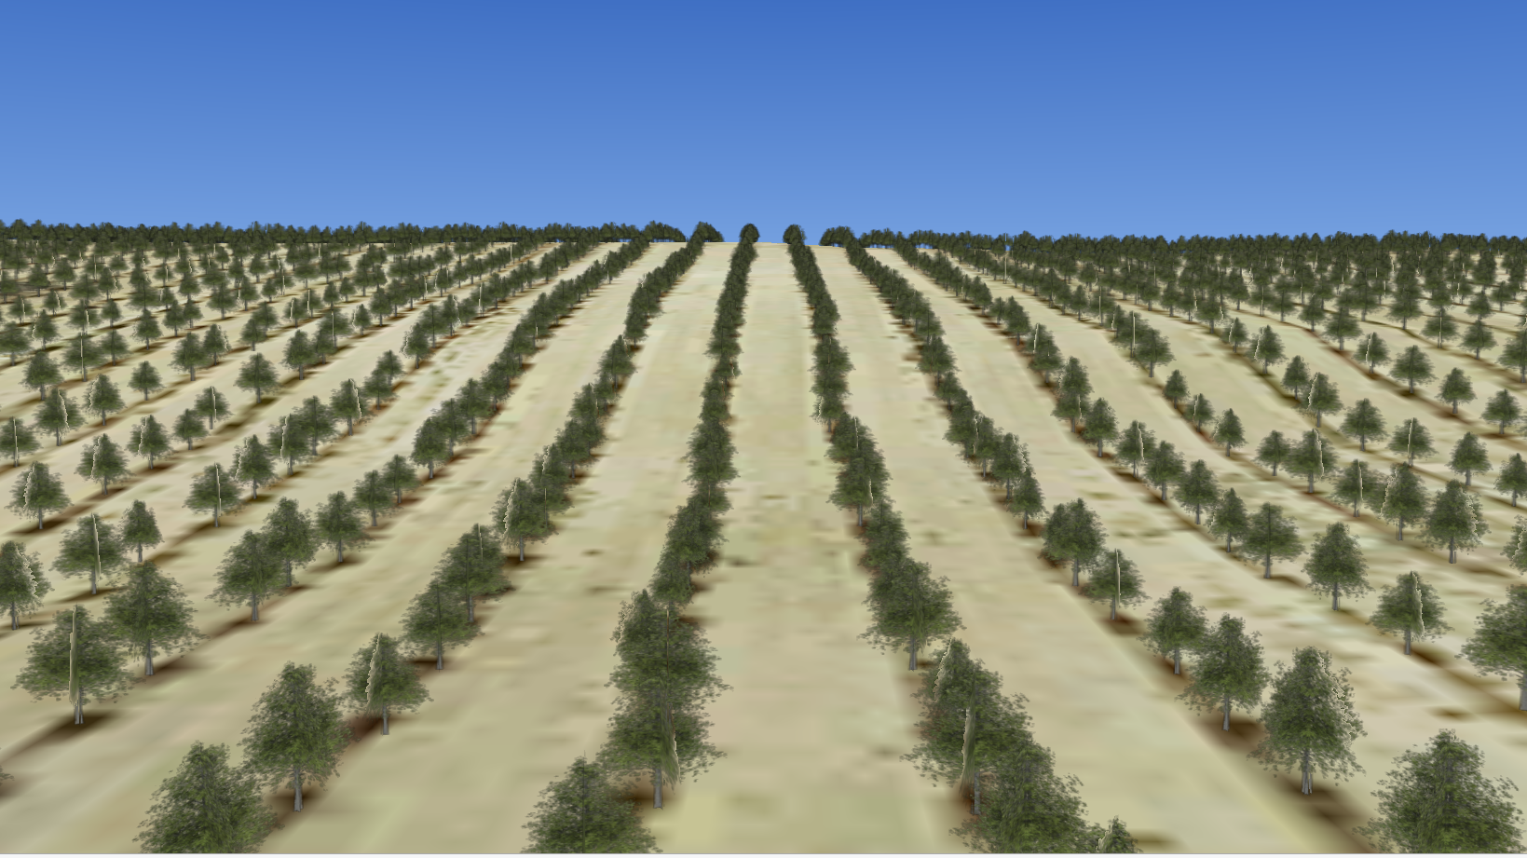
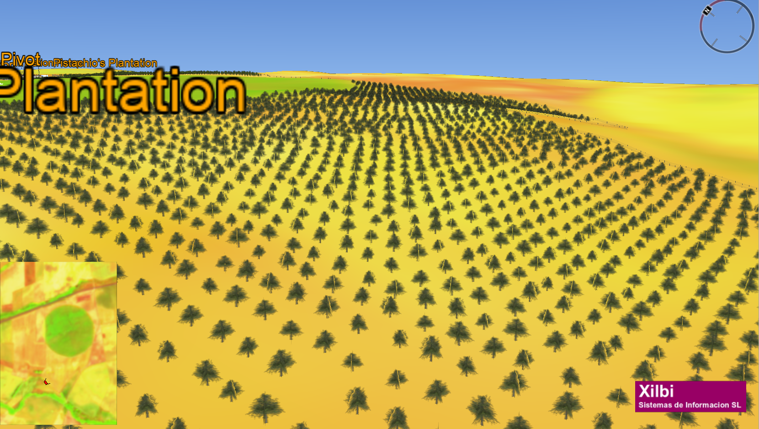
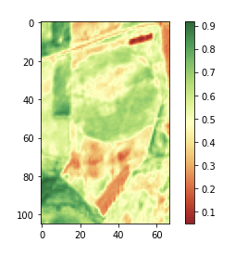
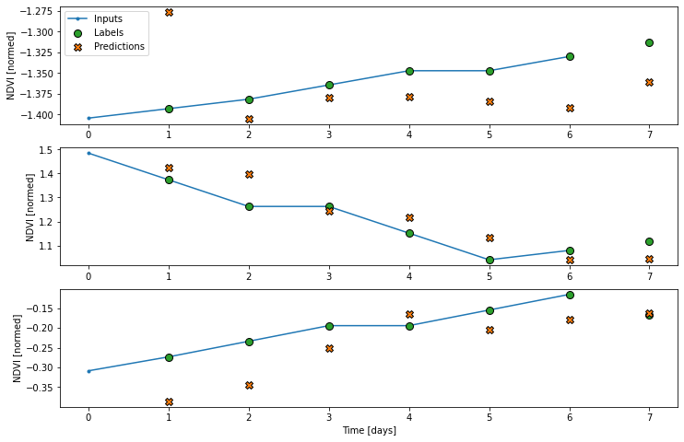
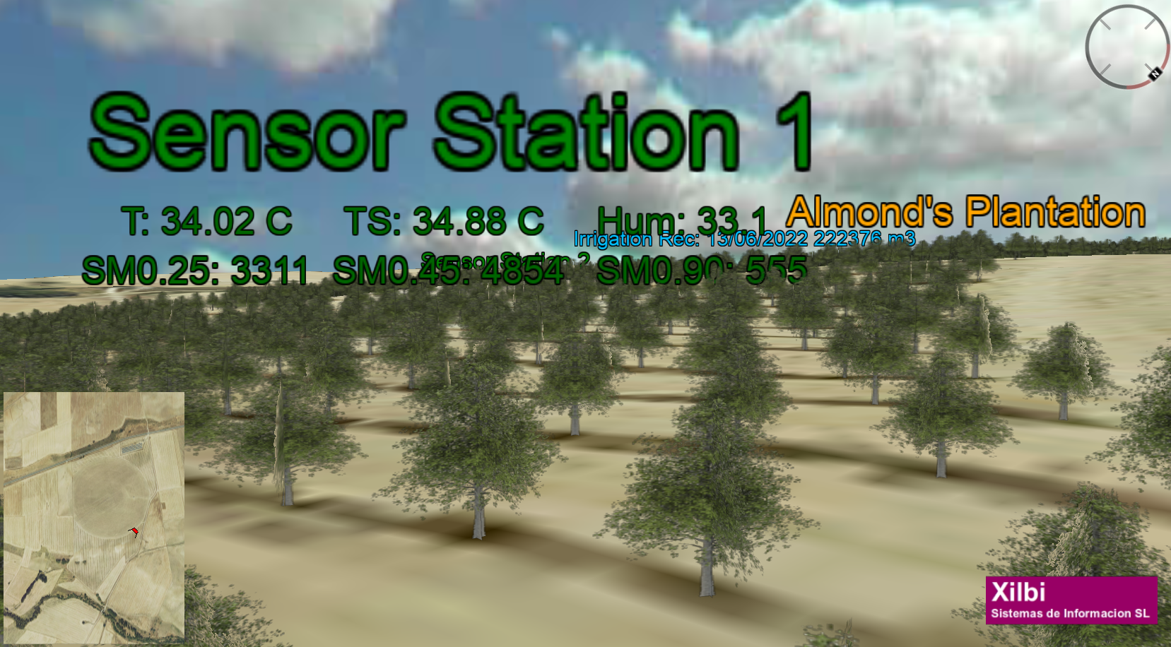
Use Case 2: Irrigation Management toolkit
Domain: Agriculture
Project: OPTIMAL
Company: Xilbi Sistemas de Informacion SL
Country: Spain
Problem: Irrigation area monitoring, water resources management and usage optimisation
Solution: DSS support applied to Almond production (irrigation requirements forecast points or maps)
AI Techniques:
  Long Short-Term Memory Neural Network using Sentinel-2 (NDVI), weather, and onsite ground environmental sensor data
AI4Copernicus services used:
  Cloud resources
  Sentinel-2 preprocessing
  Long Short-Term Memory Neural Network for Sentinel 2
  Mentoring services

Slide 18
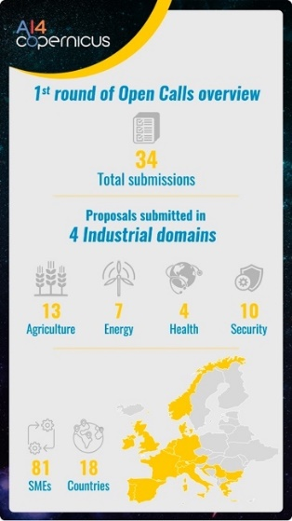
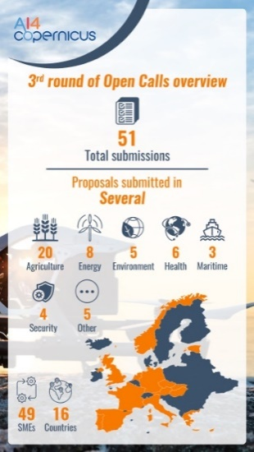
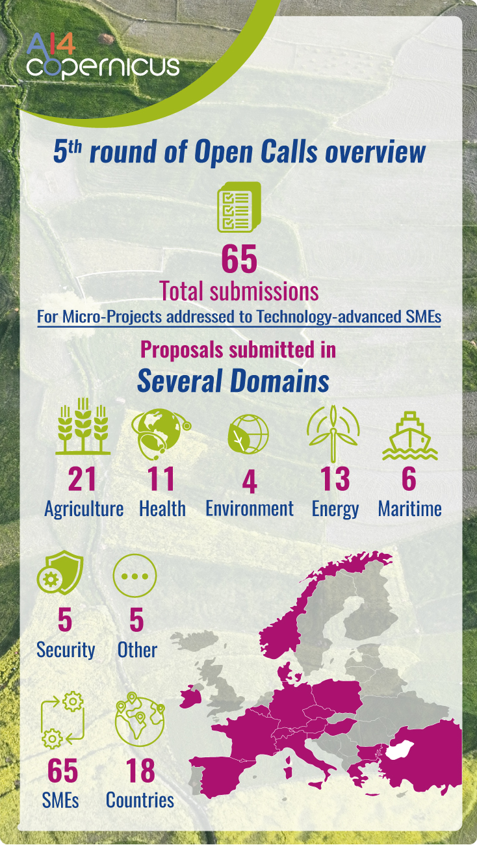
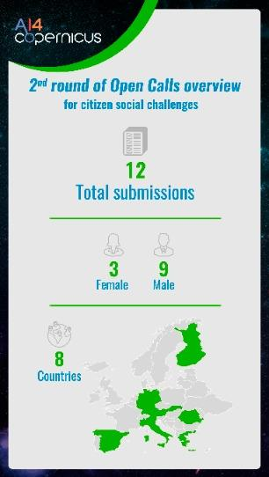
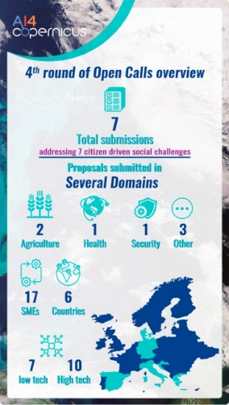
AI4Copernicus Open Calls
Open Call | #projects | Domains & #projects per domain | Status
1st | 6 | Security:3, Agriculture:2, Energy:1 | Completed
3rd | 8 | Agriculture:5, Health:1, Maritime:1, Safety/Disaster risk reduction: 1 | In Progress
4th | 3 | Urban Monitoring & Planning:1, Security:1, Agriculture:1 | In Progress
5th | 10 | Agriculture:3, Health:3, Energy:2, Environmental:1, Education:1 | In Progress
total | 27 | Security:4, Agriculture:11, Health:4, Energy:3, Other:5 | In Progress

Slide 19
Usage of AI4Copernicus services
USAGE OF BOOTSTRAPPING SERVICES
 |  | #projects using the service
Domain | Resource | used in the final product | used for testing & experiments
Security | Sentinel-1 pre-processing | 3 | 1
 | Sentinel-2 pre-processing | 2 | 2
 | Sentinel-1 change detection | - | -
 | Sentinel-2 change detection | - | -
Agriculture | Deep network for pixel-level classification of S2 patches | - | 3
 | Harmonization of pre-processed time series of Sentinel-2 data | 1 | 1
 | LST Memory Neural Network for Sentinel-2 | 2 | 3
Health | Probabilistic downscaling of CAMS air quality model data | - | 2
General | Linked Data pipeline & EarthQA | - | -
USAGE OF CLOUD RESOURCES
usage | 0% | 1-10% | 11-20% | 21-40% | 41-50% | 51-100%
#projects | 4 | 4 | 3 | 2 | 4 | 0
Projects are using security and agriculture bootstrapping services (most projects are from these domains)
Projects receive a fixed cloud resources quota either on CREODIAS or WEkEO.
Some projects are more mature and reluctant to change their workflow.
Most projects are work-in-progress, so in the forthcoming months we expect more of them to test and use the services from our framework.

Slide 20
Conclusions & Future Work
AI4Copernicus framework: A set of services and tools to bridge AI & EO, utilized by several projects and real-world use cases.
Ongoing and Future work:
  Improve the integration between our framework and AIoD
    Integration of the AI4Experiments with CREODIAS
      Enables the deployment of AI pipelines in the execution environment of CREODIAS
      Almost ready, under testing
  Develop an AI+EO section on AIoD
    Prospect of evolving into a (vertical) node within the AIoD platform

Slide 21

Thank you!
Questions?
Visit us at: https://ai4copernicus-project.eu/
The work described here has received funding from the European Union’s Horizon 2020 research and innovation programme under grant agreement No 101016798.

