Slide 1
Greedy Unsupervised Multiple Kernel Learning
Grigorios Tzortzis and Aristidis Likas
Department of Computer Science,
University of Ioannina, Greece
http://ipan.cs.uoi.gr

Slide 2
Outline
Introduction to Multiple Kernel Learning
Feature Space Clustering
Greedy Unsupervised Multiple Kernel Learning
Experimental Evaluation
Summary

Slide 3
Outline
Introduction to Multiple Kernel Learning
Feature Space Clustering
Greedy Unsupervised Multiple Kernel Learning
Experimental Evaluation
Summary

Slide 4
Kernel-based Learning
Given a dataset, $𝒳=\left\{x_{1}, x_{2},…,x_{N}\right\}{ x}_{i}∈ℝ^{d}$, and a corresponding kernel matrix, $K∈ℝ^{N×N}$, we aim at training a learner by using solely the kernel entries
Kernel methods are very effective, if an appropriate kernel for the learning task is available
Which is the most appropriate kernel?
A very difficult question to answer
The application of kernel methods is severely limited by the sensitivity to the choice of the kernel

Slide 5
Multiple Kernel Learning (MKL)
MKL idea
Instead of using a single kernel, learn a weighted combination of a set of predefined (base) kernels, to alleviate the kernel selection problem
Base kernels may describe:
Different notions of similarity in the data, e.g. through different kernel functions
Different modalities of the same instances, e.g. text, video, audio
Most MKL studies¹ address the supervised setting
Usually a linear kernel combination is adopted
This work focuses on the unsupervised setting
¹ Gönen, M., Alpaydin, E., Multiple kernel learning algorithms, JMLR, 2011

Slide 6
Sparsity of the Kernel Combination
A debate exists regarding the sparsity of the kernel combination
Usually a constraint on the combination weights controls the admissible sparsity of the solution
$ℓ_{1}$-norm¹, $ℓ_{2}$-norm², $ℓ_{p}$-norm³, weight entropy⁴
$ℓ_{1}$-norm → sparse solutions
$ℓ_{p}$-norm → less sparse solutions as $p$increases
¹ Valizadegan, H., Jin, R., Generalized maximum margin clustering and unsupervised kernel learning, NIPS, 2006
² Zhao, B., Kwok, J.T., Zhang, C., Multiple kernel clustering, SDM, 2009
³ Kloft, M., Brefeld, U., Sonnenburg, S., Laskov, P., Müller, K.R., Zien, A., Efficient and accurate lp-norm multiple kernel learning, NIPS, 2009
⁴ Lange, T., Buhmann, J.M., Fusion of similarity data in clustering, NIPS 2005

Slide 7
Sparsity of the Kernel Combination
Sparse combinations¹
Are characterized by reduced complexity and enhance interpretability
Assumption: Some kernels are irrelevant for the underlying problem, or noisy (degenerate kernels)
However
Many studies² show that they suffer from low accuracy and are even outperformed by the uniform combination
Different kernels capture different aspects of the data, hence all kernels are important, albeit to a different degree
¹ Valizadegan, H., Jin, R., Generalized maximum margin clustering and unsupervised kernel learning, NIPS, 2006
² Kloft, M., Brefeld, U., Sonnenburg, S., Laskov, P., Müller, K.R., Zien, A., Efficient and accurate lp-norm multiple kernel learning, NIPS, 2009

Slide 8
Contribution
We focus on MKL clustering and optimize the intra-cluster variance objective
We propose a linear combination for the base kernels
We incorporate a parameter to the combination that regulates the admissible sparsity of the weights
Exploit the complementary information of all available kernels
Rank kernels according to the conveyed information

Slide 9
Contribution
We devise a simple iterative procedure to recover the clusters and learn the kernel combination
Iterative frameworks are constantly gaining ground in MKL
k-medoids is utilized
The kernel mixing coefficients are estimated by closed-form expressions
We develop a greedy initialization strategy to avoid multiple restarts for k-medoids

Slide 10
Outline
Introduction to Multiple Kernel Learning
Feature Space Clustering
Greedy Unsupervised Multiple Kernel Learning
Experimental Evaluation
Summary

Slide 11
Feature Space Clustering
Dataset instances, $𝒳=\left\{x_{1}, x_{2},…,x_{N}\right\}{ x}_{i}∈ℝ^{d}$, are mapped from input space to a higher dimensional feature space $ℋ$ through a transformation $φ$
Clustering of the data is performed in space $ℋ$
Popular methods: kernel k-means, spectral clustering, SVM, PCA, CCA

Slide 12
Kernel Trick
A kernel function $𝒦$ directly provides the inner products in feature space
No explicit definition of transformation $φ$ is required
Represent the dataset through the kernel matrix $K∈ℝ^{N×N}$, $K_{ij}=𝒦\left(x_{i},x_{j}\right)={φ\left(x_{i}\right)}^{⊺}φ\left(x_{j}\right)$
Kernel matrices are symmetric and positive semidefinite matrices
Kernel methods require only the kernel matrix, not the instances
This provides flexibility in handling different data types
Euclidean distance: ${\left\|φ\left(x_{i}\right)−φ\left(x_{j}\right)\right\|}^{2}=K_{ii}−2K_{ij}+K_{jj}$

Slide 13
k-medoids in Feature Space
Given a kernel matrix $K$, split the dataset into M disjoint clusters $C_{1}, C_{2},…,C_{M}$
The cluster representatives correspond to actual data points, called medoids
Minimize the intra-cluster variance in feature space $ℋ$:
$$ℰ_{ℋ}=\sum_{i=1}^{N}{\sum_{k=1}^{M}{δ_{ik}{\left\|φ\left(x_{i}\right)−φ\left(m_{k}\right)\right\|}^{2}} }=\sum_{i=1}^{N}{\sum_{k=1}^{M}{δ_{ik}(K_{ii}−2K_{il_{k}}+K_{l_{k}l_{k}})} }$$
$m_{k}∈𝒳$ is the k-th cluster medoid
$δ_{ik}=1 if x_{i}∈C_{k}$, $δ_{ik}=0 if x_{i}∉C_{k}$
$l_{k}$ is the index of the data point corresponding to the k-th medoid

Slide 14
k-medoids in Feature Space
Iteratively assign instances to their closest medoid and update the medoids
Monotonic convergence to a local minimum
Strong dependence on the initialization of the medoids
To circumvent the poor minima issue we develop a greedy method for selecting initial medoids
Similar to the fast global kernel k-means approach¹
¹ Tzortzis, G., Likas, A., The global kernel k-means algorithm for clustering in feature space, IEEE TNN, 2009

Slide 15
Greedy Medoid Initialization
Incremental approach that deterministically identifies a set of M medoids to initialize the k-medoids algorithm
Start with one medoid
At each stage a new medoid is added
Until M medoids are selected
Idea
Given k-1 medoids, an appropriate representative for the k-th cluster can be located by selecting the instance $x_{j^{∗}}$ that guarantees the greatest reduction of the intra-cluster variance $ℰ_{ℋ}$, as the k-th medoid

Slide 16
Greedy Medoid Initialization
Start by considering the whole dataset as one cluster
Choose the medoid of the dataset as the first medoid $m_{1}$
Suppose that k-1 medoids have already been added
If instance $x_{j}$ is selected as the k-th medoid, it will allocate all instances that are closer to $x_{j}$ in feature space than to their current cluster medoid (in the solution with k-1 clusters)
The reduction caused by the reallocation is:
$$b_{j}^{(k)}=\sum_{i=1}^{N}{max}\{d_{i}^{\left(k−1\right)}−{\left\|φ\left(x_{j}\right)−φ\left(x_{i}\right)\right\|}^{2} , 0\}$$
$d_{i}^{\left(k−1\right)}$ is the distance, in feature space, between $x_{i}$ and its cluster medoid, in the solution with k-1 clusters

Slide 17
Greedy Medoid Initialization
Suppose that k-1 medoids have already been added
Set $x_{j^{∗}}$as the k-th medoid, $m_{k}=$ $x_{j^{∗}}$, where $j^{∗}=\underset{j}{argmax}{b_{j}^{(k)}}$
Assign all instances $x_{i}$ for which $d_{i}^{\left(k−1\right)}>{\left\|φ\left(x_{j^{∗}}\right)−φ\left(x_{i}\right)\right\|}^{2}$ to the new medoid
Repeat until k=M

Slide 18
Outline
Introduction to Multiple Kernel Learning
Feature Space Clustering
Greedy Unsupervised Multiple Kernel Learning
Experimental Evaluation
Summary

Slide 19
Greedy Unsupervised Multiple Kernel Learning (GUMKL)
We propose an extension of the k-medoids objective to unsupervised multiple kernel learning, that also differentiates and ranks the kernels according to the conveyed information
Why?
k-medoids is a simple, yet effective clustering technique
Different kernels capture different aspects of the data and thus contain complementary information
Degenerate kernels that degrade performance also exist in practice

Slide 20
Greedy Unsupervised Multiple Kernel Learning (GUMKL)
Target
Split the dataset by simultaneously considering all kernels
Automatically determine the relevance of each kernel to the clustering task
How?
Associate a weight with each kernel
Learn a linear combination of the kernels together with the clustering
Weights determine the degree that each kernel contributes to the clustering solution

Slide 21
Kernel Mixing
Given a dataset $𝒳=\left\{x_{1}, x_{2},…,x_{N}\right\},{ x}_{i}∈ℝ^{d}$
Assume that V kernel matrices are available, $K^{(v)}$, to which transformations $φ^{(v)}$ and feature spaces $ℋ^{(v)}$ correspond
Define a composite kernel:
$$\tilde{K}=\sum_{v=1}^{V}{w_{v}^{p}K^{(v)}}, w_{v}≥0, \sum_{v=1}^{V}{w_{v}}=1, p≥1$$
$\tilde{K}$ is a valid kernel matrix with transformation $\tilde{φ}$ and feature space $\tilde{ℋ}$
$w_{v}$ are the weights that reflect the contribution of each kernel
$p$ is an exponent controlling the distribution of the weights across the kernels

Slide 22
GUMKL Objective
Split the dataset into M disjoint clusters $C_{1}, C_{2},…,C_{M}$ and simultaneously learn the composite kernel, $\tilde{K}$, weights
Minimize the intra-cluster variance in feature space $\tilde{ℋ}$:
$$\min_{C_{k},w_{v}}{ℰ_{\tilde{ℋ}}}, s.t. w_{v}≥0, \sum_{v=1}^{V}{w_{v}}=1$$
$$ℰ_{\tilde{ℋ}}=\sum_{i=1}^{N}{\sum_{k=1}^{M}{δ_{ik}{\left\|\tilde{φ}\left(x_{i}\right)−\tilde{φ}\left(m_{k}\right)\right\|}^{2}}}$$
Parameter $p$ is not part of the optimization and must be set a priori
Distance calculations require only the kernel matrices
$m_{k}∈𝒳$ is the k-th cluster medoid
$δ_{ik}=1 if x_{i}∈C_{k}$, $δ_{ik}=0 if x_{i}∉C_{k}$

Slide 23
GUMKL Objective
The objective can be rewritten as:
$$ℰ_{\tilde{ℋ}}=\sum_{v=1}^{V}{w_{v}^{p}\sum_{i=1}^{N}{\sum_{k=1}^{M}{δ_{ik}\left(K_{ii}^{\left(v\right)}−2K_{il_{k}}^{\left(v\right)}+K_{l_{k}l_{k}}^{(v)}\right)}}}$$
$l_{k}$ is the index of the data point corresponding to the k-th medoid
$$ℰ_{ℋ^{(v)}}$$
The intra-cluster variance in space $\tilde{ℋ}$ is the weighted sum of the intra-cluster variances in the individual feature spaces $ℋ^{(v)}$, under a common clustering

Slide 24
GUMKL Training
Iteratively update the clusters and the kernel weights
Cluster Update
Keep the weights fixed
Compute the composite kernel $\tilde{K}$
Apply the greedy medoid initialization procedure to pick initial medoids
Employ k-medoids in space $\tilde{ℋ}$ to get the cluster assignments and their representatives
The medoids are greedily reinitialized at each iteration
Previous iteration medoids may be inappropriate, if the weights change significantly

Slide 25
GUMKL Training
Weight Update
Keep the clusters fixed
The objective is convex w.r.t. the weights for $p≥1$
Closed-form updates:
$$w_{v}=1/{\sum_{v′=1}^{V}{{\left(\frac{ℰ_{ℋ^{(v)}} }{ℰ_{ℋ^{(v′)}} }\right)}^{\frac{1}{p−1}}}}, p>1$$
$$w_{v}=\left\{\begin{aligned}1,v={argmin}_{v′}{ ℰ}_{ℋ^{(v′)}} \\ 0, otherwise\end{aligned}\right., p=1$$

Slide 26
Weight Update Analysis
$$w_{v}=1/{\sum_{v′=1}^{V}{{\left(\frac{ℰ_{ℋ^{(v)}} }{ℰ_{ℋ^{(v′)}} }\right)}^{\frac{1}{p−1}}}}, p>1$$
$$w_{v}=\left\{\begin{aligned}1,v={argmin}_{v′}{ ℰ}_{ℋ^{(v′)}} \\ 0, otherwise\end{aligned}\right., p=1$$
The quality of the kernels is measured in terms of the intra-cluster variance in the corresponding feature space
Higher variance results in a smaller kernel weight
Smaller $p$ values enhance the differences among the kernels, resulting in sparser weights $w_{v}$
Small $p$ values are useful when few kernels are of good quality
High $p$ values are useful when all kernels are equally important
Intermediate $p$ values are more realistic in practice

Slide 27
Outline
Introduction to Multiple Kernel Learning
Feature Space Clustering
Greedy Unsupervised Multiple Kernel Learning
Experimental Evaluation
Summary

Slide 28
Experimental Evaluation
We compared GUMKL for various $p$ values to two baselines:
The best single kernel ($p=1$)
Uniform weighting ($w_{v}=1/V$)
Goals
Investigate the impact of the $p$ value
Examine the efficacy of kernel weighting under GUMKL

Slide 29
Dataset
Corel¹ – Image collection
34 classes
100 instances per class
Great variance in terms of color, lighting, and background composition within each class
Seven modalities (color and texture) are available, which naturally produce seven base kernels
We extracted several four class subsets for the experiments
¹ http://www.cs.virginia.edu/~xj3a/research/CBIR/Download.htm

Slide 30
Experimental Setup
Linear kernels are adopted for all modalities
The number of clusters is set equal to the true number of classes in the dataset
Performance is measured in terms of NMI
Higher NMI values indicate a better match between cluster and class labels
On the following we present results for five representative subsets of the corel collection

Slide 31
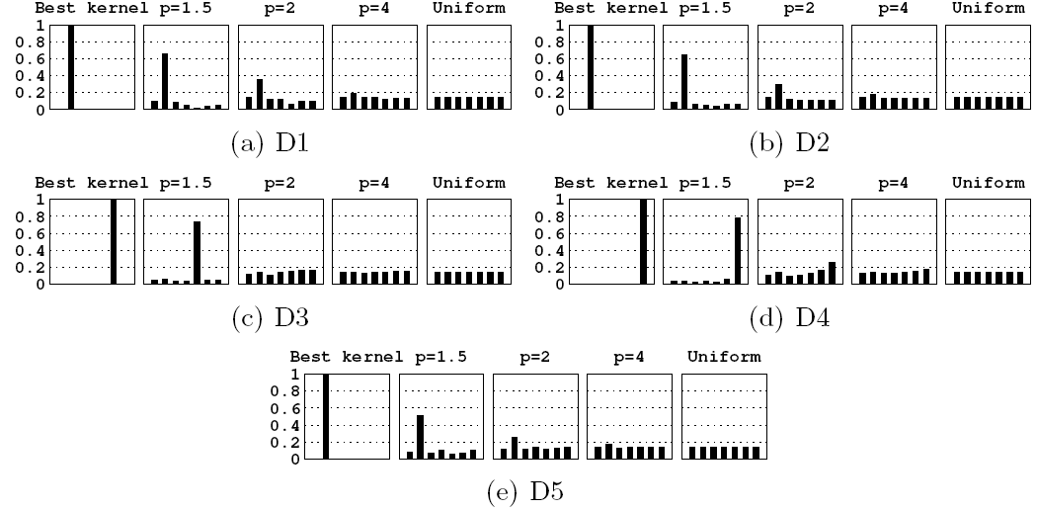
Weight Distribution
As $p$ increases the weights distribution becomes less sparse

Slide 32
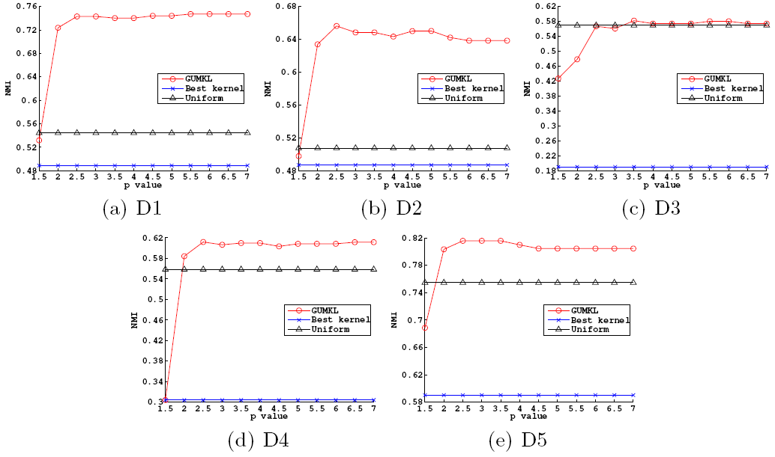
Clustering Performance

Slide 33
Conclusions
GUMKL systematically outperforms both baselines
Exploiting multiple kernels and appropriately ranking these kernels can boost clustering accuracy → Assign weights to the kernels
A single kernel ($p=1$) is even worse than equally considering all kernels
Choosing a single kernel results in loss of information
Sparse solutions suffer from poor performance
GUMKL seems to be quite insensitive to the choice of $p$, if extremes are avoided
$2.5≤p≤3.5$ achieves the highest NMI
A balance between high sparsity and high uniformity is preferable
Controlling the distribution of the weights ($p$ parameter) is important

Slide 34
Outline
Introduction to Multiple Kernel Learning
Feature Space Clustering
Greedy Unsupervised Multiple Kernel Learning
Experimental Evaluation
Summary

Slide 35
Summary
We studied the multiple kernel learning problem under the unsupervised setting
We proposed an iterative method for linearly combining a set of base kernels by optimizing the intra-cluster variance objective
We derived closed-form expressions for the weights
We introduced a parameter that moderates the sparsity of the weights, allowing all kernels to contribute to the solution, albeit with distinct degrees
We provided experimental results for the efficacy of our framework

Slide 36
Thank you!

