Slide 1
Kernel-based Weighted Multi-view Clustering
Grigorios Tzortzis and Aristidis Likas
Department of Computer Science,
University of Ioannina, Greece

Slide 2
Outline
Introduction
Feature Space Clustering
Kernel-based Weighted Multi-view Clustering
Experimental Evaluation
Summary

Slide 3
Outline
Introduction
Feature Space Clustering
Kernel-based Weighted Multi-view Clustering
Experimental Evaluation
Summary

Slide 4
Multi-view Data
Most machine learning approaches assume instances are represented by a single feature space
In many real life problems multi-view data arise naturally
Different measuring methods – Infrared and visual cameras
Different media – Text, video, audio
Multi-view data are instances with multiple representations from different feature spaces, e.g. different vector and/or graph spaces

Slide 5
Examples of Multi-view Data
Web pages
Web page text
Anchor text
Hyper-links
Scientific articles
Abstract text
Citations graph
Images
Color
Texture
Annotation Text
Such data have raised interest in a novel problem, called multi-view learning
Most studies address the semi-supervised setting
We will focus on unsupervised clustering of multi-view data

Slide 6
Multi-view Clustering
Given a multiply represented dataset, split this dataset into M disjoint - homogeneous groups, by taking into account every view
Motivation
Views capture different aspects of the data and may contain complementary information
A robust partitioning could be derived by simultaneously exploiting all views, that outperforms single view segmentations
Simple solution
Concatenate the views and apply a classic clustering algorithm
Not very effective

Slide 7
Multi-view Clustering
Most existing multi-view methods rely equally on all views
Degenerate views often occur – Noisy, irrelevant views
Results will deteriorate if such views are included in the clustering process
Views should participate in the solution according to their quality
A view ranking mechanism is necessary

Slide 8
Contribution
We focus on multi-view clustering and rank the views based on their conveyed information
This issue has been overlooked in the literature
We represent each view with a kernel matrix and combine the views using a weighted sum of the kernels
Weights express the quality of the views and determine the amount of their contribution to the solution
We incorporate in our model a parameter that controls the sparsity of the weights
This parameter adjusts the sensitivity of the weights to the differences in quality among the views

Slide 9
Contribution
We develop two simple iterative procedures to recover the clusters and automatically learn the weights
Kernel k-means and its spectral relaxation are utilized
The weights are estimated by closed-form expressions
We perform experiments with synthetic and real data to evaluate our framework

Slide 10
Outline
Introduction
Feature Space Clustering
Kernel-based Weighted Multi-view Clustering
Experimental Evaluation
Summary

Slide 11
Feature Space Clustering
Dataset points, $𝒳=\left\{x_{1}, x_{2},…,x_{N}\right\}{ x}_{i}∈ℝ^{d}$, are mapped from input space to a higher dimensional feature space $ℋ$ via a nonlinear transformation $φ$
Clustering of the data is performed in space $ℋ$
Non-linearly separable clusters are identified in input space and the structure of the data is better explored

Slide 12
Kernel Trick
A kernel function $𝒦$ directly provides the inner products in feature space using the input space representations
No explicit definition of transformation $φ$ is necessary
The transformation is intractable for certain kernel functions
The dataset is represented through the kernel matrix $K∈ℝ^{N×N}$, $K_{ij}=𝒦\left(x_{i},x_{j}\right)={φ\left(x_{i}\right)}^{⊺}φ\left(x_{j}\right)$
Kernel matrices are symmetric and positive semidefinite matrices
Kernel-based methods require only the kernel matrix entries during training and not the instances
This provides flexibility in handling different data types
Euclidean distance: ${\left\|φ\left(x_{i}\right)−φ\left(x_{j}\right)\right\|}^{2}=K_{ii}−2K_{ij}+K_{jj}$

Slide 13
Kernel k-means
Given a kernel matrix $K$, split the dataset into M disjoint clusters $C_{1}, C_{2},…,C_{M}$
Minimize the intra-cluster variance in feature space:
$$ℰ_{ℋ}=\sum_{i=1}^{N}{\sum_{k=1}^{M}{δ_{ik}{\left\|φ\left(x_{i}\right)−m_{k}\right\|}^{2}},m_{k}=\frac{\sum_{i=1}^{N}{δ_{ik}φ\left(x_{i}\right)}}{\sum_{i=1}^{N}{δ_{ik}}}}$$
$m_{k}$ is the k-th cluster center (cannot be analytically calculated)
$δ_{ik}=1 if x_{i}∈C_{k}$, $δ_{ik}=0 if x_{i}∉C_{k}$
Kernel k-means ≡ k-means in feature space

Slide 14
Kernel k-means
Iteratively assign instances to their closest center in feature space
Distance calculation: ${\left\|φ\left(x_{i}\right)−m_{k}\right\|}^{2}=K_{ii}−\frac{2\sum_{j=1}^{N}{δ_{jk}K_{ij}}}{\sum_{j=1}^{N}{δ_{jk}}}+\frac{\sum_{j=1}^{N}{\sum_{l=1}^{N}{δ_{jk}δ_{lk}K_{jl}}}}{\sum_{j=1}^{N}{\sum_{l=1}^{N}{δ_{jk}δ_{lk}}}}$
Monotonic convergence to a local minimum
Strongly depends on the initialization of the clusters
Global kernel k-means¹ is a deterministic-incremental approach that circumvents the poor minima issue
¹ Tzortzis, G., Likas, A., The global kernel k-means algorithm for clustering in feature space, IEEE TNN, 2009

Slide 15
Spectral Relaxation of Kernel k-means
The intra-cluster variance can be written in trace terms¹:
$$ℰ_{ℋ}=tr\left(K\right)−tr\left(Y^{⊺}KY\right), Y∈ℝ^{N×M}, Y_{ik}=\frac{δ_{ik}}{\sqrt{\sum_{j=1}^{N}{δ_{jk}}}}$$
If $Y$ is allowed to be an arbitrary orthonormal matrix, a relaxed version of $ℰ_{ℋ}$ can be optimized via spectral analysis:
$\max_{Y}{tr(Y^{⊺}KY)}$, ${s.t. Y}^{⊺}Y=I$
The optimal $Y$ consists of the top M eigenvectors of $K$
Post-processing is performed on $Y$ to get discrete clusters
Constant
Spectral methods can substitute kernel k-means and vice versa
¹ Dhillon, I.S., Guan, Y., Kulis, B., Weighted graph cuts without eigenvectors: A multilevel approach, IEEE TPAMI, 2007

Slide 16
Outline
Introduction
Feature Space Clustering
Kernel-based Weighted Multi-view Clustering
Experimental Evaluation
Summary

Slide 17
Kernel-based Weighted Multi-view Clustering
We propose an extension of the kernel k-means objective to the multi-view setting that:
Ranks the views based on the quality of the conveyed information
Differentiates their contribution to the solution according to the ranking
Why?
Kernel k-means is a simple, yet effective clustering technique
Complementary information in the views can boost clustering accuracy
Degenerate views that degrade performance exist in practice
Target
Split the dataset by simultaneously considering all views
Automatically determine the relevance of each view to the clustering task
How?
Represent views with kernels
Associate a weight with each kernel
Learn a linear combination of the kernels together with the cluster labels
Weights determine the degree that each kernel-view participates in the solution and should reflect its quality

Slide 18
Kernel mixing
Given a dataset $𝒳$ with N instances and V views:
Assume a kernel matrix, $K^{(v)}$, is available for the v-th view to which transformation $φ^{(v)}$ and feature space $ℋ^{(v)}$ corresponds
Define a composite kernel by combining the view kernels:
$$\tilde{K}=\sum_{v=1}^{V}{w_{v}^{p}K^{(v)}}, w_{v}≥0, \sum_{v=1}^{V}{w_{v}}=1, p≥1$$
$\tilde{K}$ is a valid kernel matrix with transformation $\tilde{φ}$ and feature space $\tilde{ℋ}$ that carries information from all views
$w_{v}$ are the weights that regulate the contribution of each kernel (view)
$p$ is a user specified exponent controlling the distribution of the weights across the kernels (views)
The $w_{v}^{p}$ values are the actual kernel mixing coefficients
$$𝒳=\left\{𝔁_{1}, 𝔁_{2},…,𝔁_{N}\right\}, 𝔁_{i}=\left\{x_{i}^{(1)},x_{i}^{(2)},…,x_{i}^{(V)}\right\}, x_{i}^{(v)}∈ℝ^{d^{(v)}}$$

Slide 19
Multi-view Kernel k-means (MVKKM)
Split the dataset into M disjoint clusters $C_{1}, C_{2},…,C_{M}$ and simultaneously exploit all views by learning appropriate weights for the composite kernel $\tilde{K}$
Minimize the intra-cluster variance in feature space $\tilde{ℋ}$ :
$$\min_{C_{k},w_{v}}{ℰ_{\tilde{ℋ}}}, s.t. w_{v}≥0, \sum_{v=1}^{V}{w_{v}}=1$$
$$ℰ_{\tilde{ℋ}}=\sum_{i=1}^{N}{\sum_{k=1}^{M}{δ_{ik}{\left\|\tilde{φ}\left(𝔁_{i}\right)−{\tilde{m}}_{k}\right\|}^{2}},{\tilde{m}}_{k}=\frac{\sum_{i=1}^{N}{δ_{ik}\tilde{φ}\left(𝔁_{i}\right)}}{\sum_{i=1}^{N}{δ_{ik}}}}$$
Parameter $p$ is not part of the optimization and must be fixed a priori
Distance calculations require only the kernel matrices

Slide 20
Multi-view Kernel k-means (MVKKM)
The objective can be rewritten as:
$$ℰ_{\tilde{ℋ}}=\sum_{v=1}^{V}{w_{v}^{p}\sum_{i=1}^{N}{\sum_{k=1}^{M}{δ_{ik}{\left\|φ^{(v)}\left(x_{i}^{(v)}\right)−m_{k}^{(v)}\right\|}^{2}}}},m_{k}^{(v)}=\frac{\sum_{i=1}^{N}{δ_{ik}φ^{(v)}\left(x_{i}^{(v)}\right)}}{\sum_{i=1}^{N}{δ_{ik}}}$$
$$𝒟_{v}$$
The intra-cluster variance in space $\tilde{ℋ}$ is the weighted sum of the views’ intra-cluster variances $𝒟_{v}$, under a common clustering $δ_{ik}$

Slide 21
MVKKM Training
Iteratively update the clusters and the weights
Cluster Update
The weights are kept fixed
Compute the composite kernel $\tilde{K}$
Apply kernel k-means using $\tilde{K}$ as the kernel matrix
The derived clusters utilize information from all views based on $\tilde{K}$
Weight Update
The clusters are kept fixed
The objective is convex w.r.t. the weights for $p≥1$
Closed form updates:
$$w_{v}=1/{\sum_{v′=1}^{V}{{\left(\frac{𝒟_{v}}{𝒟_{v′}}\right)}^{\frac{1}{p−1}}}}, p>1$$
$$w_{v}=\left\{\begin{aligned}1,v={argmin}_{v′}D_{v′} \\ 0, otherwise\end{aligned}\right., p=1$$

Slide 22
Weight Update Analysis
$$w_{v}=1/{\sum_{v′=1}^{V}{{\left(\frac{𝒟_{v}}{𝒟_{v′}}\right)}^{\frac{1}{p−1}}}}, p>1$$
$$w_{v}=\left\{\begin{aligned}1,v={argmin}_{v′}D_{v′} \\ 0, otherwise\end{aligned}\right., p=1$$
The quality of the views is measured in terms of their intra-cluster variance
Views with lower intra-cluster variance (better quality) receive higher weights and thus contribute more strongly to $\tilde{K}$
Smaller (higher) $p$ values enhance (suppress) the relative differences in $𝒟_{v}$, resulting in sparser (more uniform) weights, $w_{v}$, and mixing coefficients $w_{v}^{p}$
Small $p$ values are useful when few kernels are of good quality
High $p$ values are useful when all kernels are equally important
Intermediate $p$ values constitute a compromise in the absence of prior knowledge about the validity of the above two cases

Slide 23
Multi-view Spectral Clustering (MVSpec)
Explore the spectral relaxation of kernel k-means and employ spectral clustering to optimize the MVKKM objective
The MVKKM objective can be written in trace terms:
$$ℰ_{\tilde{ℋ}}=tr\left(\tilde{K}\right)−tr\left(Y^{⊺}\tilde{K}Y\right)=\sum_{v=1}^{V}{w_{v}^{p}}\left(tr\left(K^{(v)}\right)−tr\left(Y^{⊺}K^{(v)}Y\right)\right), Y∈ℝ^{N×M}, Y_{ik}=\frac{δ_{ik}}{\sqrt{\sum_{j=1}^{N}{δ_{jk}}}}$$
Applying spectral relaxation yields the following optimization problem:
$$\min_{Y,w_{v}}{tr\left(\tilde{K}\right)−tr\left(Y^{⊺}\tilde{K}Y\right)}, s.t. w_{v}≥0, \sum_{v=1}^{V}{w_{v}}=1,Y^{⊺}Y=I$$

Slide 24
MVSpec Training
Iteratively update the clusters and the weights
Cluster Update
The weights are kept fixed
Compute the composite kernel $\tilde{K}$
The optimization reduces to $\max_{Y}{tr\left(Y^{⊺}\tilde{K}Y\right)},$ $s.t. Y^{⊺}Y=I$
$Y$ is composed of the M largest eigenvectors of $\tilde{K}$ (relaxed clusters) and is optimal given the weights
Weight Update
Matrix $Y$ is kept fixed
The MVKKM formulas also apply to this case
$𝒟_{v}=tr\left(K^{(v)}\right)−tr\left(Y^{⊺}K^{(v)}Y\right)$ (relaxed intra-cluster variance)

Slide 25
MVKKM vs. MVSpec
MVKKM | MVSpec
Weight initialization ($w_{v}=1/V)$ Cluster initialization (global kernel k-means) | Weight initialization ($w_{v}=1/V)$ Eigenvector post-processing (k-means)
Monotonic convergence to a local minimum | Monotonic convergence to a local minimum
Discrete clusters are derived at each iteration | Non discrete clusters are derived at each iteration (top eigenvectors of $\tilde{K}$) -This continuous solution is optimal in each iteration, but w.r.t. the relaxed version of the objective $ℰ_{\tilde{ℋ}}$ -The relaxation may deviate from the actual objective
$O\left(N^{2}(V+τ)τ′\right)$ complexity | $O\left(N^{2}MVτ′\right)$ complexity

Slide 26
Outline
Introduction
Feature Space Clustering
Kernel-based Weighted Multi-view Clustering
Experimental Evaluation
Summary

Slide 27
Experimental Evaluation
We compared MVKKM and MVSpec for various $p$ values to:
The best single view ($p=1$) baseline
The uniform combination ($w_{v}=1/V$) baseline
Correlational spectral clustering (CSC)¹
The views are projected through kernel canonical correlation analysis
All views are considered equally important (view weighting is not available)
Weighted multi-view convex mixture models (MVCMM)²
Each view is modeled by a convex mixture model
An automatically tuned weight is associated with each view
¹ Blaschko, M. B., Lampert, C. H., Correlational spectral clustering, CVPR, 2008
² Tzortzis, G., Likas, A., Multiple View Clustering Using a Weighted Combination of Exemplar-based Mixture Models, IEEE TNN, 2010

Slide 28
Experimental Setup
MVKKM and MVSpec weights are uniformly initialized
Global kernel k-means¹ is utilized to deterministically get initial clusters for MVKKM
Multiple restarts are avoided
Linear kernels are employed for all views
For MVCMM, Gaussian convex mixture models are adopted
The number of clusters is set equal to the true number of classes in the dataset
Performance is measured in terms of NMI
Higher NMI values indicate a better match between cluster and class labels
¹ Tzortzis, G., Likas, A., The global kernel k-means algorithm for clustering in feature space, IEEE TNN, 2009

Slide 29
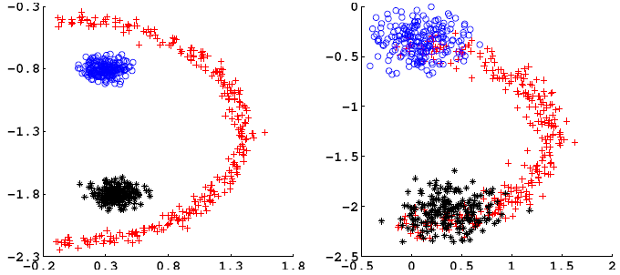
Synthetic Data
We created a two view dataset
The second view is a noisy version of the first that mixes the clusters
The dataset is not linearly separable
Use rbf kernels to represent the views

Slide 30
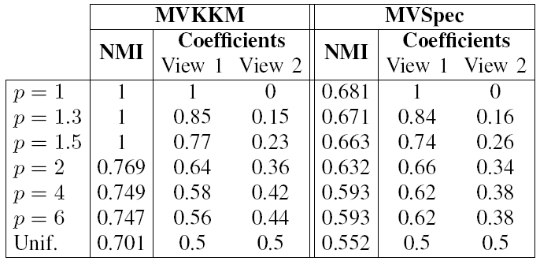
Synthetic Data
NMI score and kernel mixing coefficients distribution (${w_{v}^{p}}/{\sum_{v^{′}=1}^{V}{w_{v^{′}}^{p}}}$)
As $p$ increases the coefficients, $w_{v}^{p}$, become more uniform
The solution is severely influenced by the noisy view
Small $p$ values are appropriate for this dataset
The coefficients are consistent with the noise level in the views
The clusters are correctly recovered (for MVKKM)
MVSpec fails despite providing similar coefficients to MVKKM
We observed that spectral clustering in the first view alone also fails

Slide 31
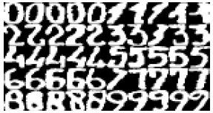
Real Multi-view Datasets
Multiple Features – Collection of handwritten digits
Five views
Ten classes
200 instances per class
Extracted several four class subsets
Corel – Image collection
Seven views (color and texture)
34 classes
100 instances per class
Extracted several four class subsets

Slide 32
Multiple Features
Digits 0236
Digits 1367
Kernel mixing coefficients distribution (${w_{v}^{p}}/{\sum_{v^{′}=1}^{V}{w_{v^{′}}^{p}}}$).
MVKKM → yellow, MVSpec → black
As $p$ increases the coefficients, $w_{v}^{p}$, become less sparse
MVSpec exhibits a more “peaked” distribution

Slide 33
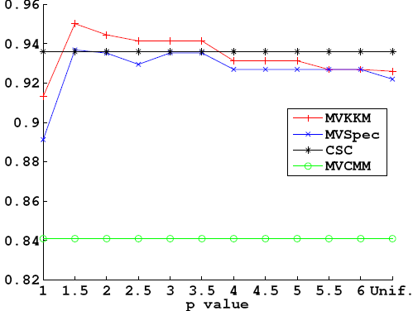
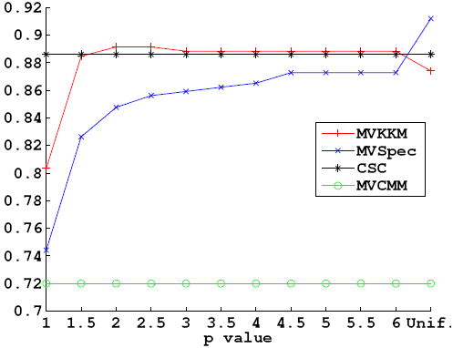
Multiple Features
Digits 0236
Digits 1367
MVKKM is superior to MVSpec for almost all $p$ values
High sparsity ($p=1$ – single view) yields the least NMI
All views are similarly important since:
The uniform case is close in accuracy to the best $p$
As $p$ increases only a minor drop in NMI is observed
CSC is quite competitive despite equally considering all views
Some sparsity can still enhance performance ($p=1.5, 2$ in MVKKM)

Slide 34
Corel
bus, leopard, train, ship
owl, wildlife, hawk, rose
Kernel mixing coefficients distribution (${w_{v}^{p}}/{\sum_{v^{′}=1}^{V}{w_{v^{′}}^{p}}}$).
MVKKM → yellow, MVSpec → black
As $p$ increases the coefficients, $w_{v}^{p}$, become less sparse
MVSpec exhibits a more “peaked” distribution
MVKKM and MVSpec prefer different views
The relaxed objective of MVSpec leads to the selection of suboptimal views

Slide 35
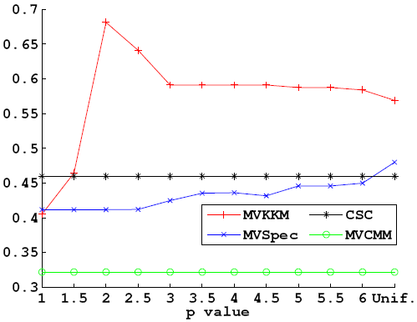
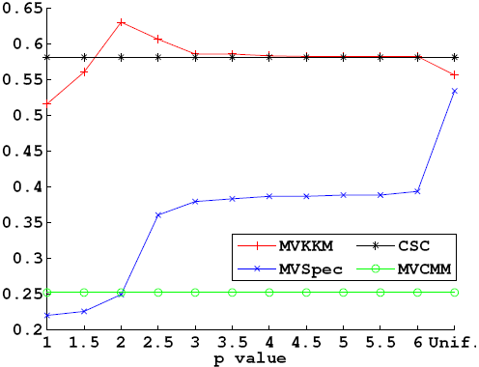
Corel
bus, leopard, train, ship
owl, wildlife, hawk, rose
MVKKM for $p=2$ considerably outperforms all algorithms
A nonuniform combination of the views is suited to this dataset
Very sparse combinations ($p=1, 1.5$) attain the lowest NMI
MVSpec underperforms as inappropriate views are selected
The influence of suboptimal views is amplified for sparser solutions, explaining the gain in NMI as $p$ increases
MVCMM produces a very sparse outcome, thus it achieves poor results

Slide 36
Evaluation Conclusions
MVKKM is the best of the tested methods
Selecting either the best view or equally all views proves inadequate
A balance between high sparsity and high uniformity is preferable
Exploiting multiple views and appropriately ranking these views improves clustering results
The choice of $p$ is dataset dependent
A single view ($p=1$) is even worse than uniformly mixing all views
Choosing a single view results in loss of information
Relaxing the objective needs caution
Deviation from the actual objective is possible
More prominent in iterative schemes, such as MVSpec

Slide 37
Outline
Introduction
Feature Space Clustering
Kernel-based Weighted Multi-view Clustering
Experimental Evaluation
Summary

Slide 38
Summary
We studied the multi-view problem under the unsupervised setting and represented views with kernels
We proposed two iterative methods that rank the views by learning a weighted combination of the view kernels
We introduced a parameter that moderates the sparsity of the weights
We derived closed-form expressions for the weights
We provided experimental results for the efficacy of our framework

Slide 39
Thank you!

